Slide 1
Jermyn Borough Council Meeting
4/20/2023

Slide 2
Meeting Agenda
April 20, 2023
CALL TO ORDER
PLEDGE OF ALLEGIANCE
ROLL CALL
PREVIOUS MEETING MINUTES
TREASURER REPORT/BILLS PAYABLE
SECRETARY REPORT
CORRESPONDENCE
PUBLIC COMMENT
PROFESSIONAL REPORTS
POLICE
FIRE
SOLICITOR
CODE ENFORCEMENT
ZONING
ENGINEER
TAX COLLECTOR
MAYOR
COMMITTEE REPORTS
SAFETY
PLANNING
FINANCE
SHADE TREE
REC
MS4
DPW
CODE ENFORCEMENT
WOODLANDS SEWER PROJECT
RESOLUTION FOR PENSION
JERMYN 150 DONATION
OLD BUSINESS
NEW BUSINESS

Slide 3
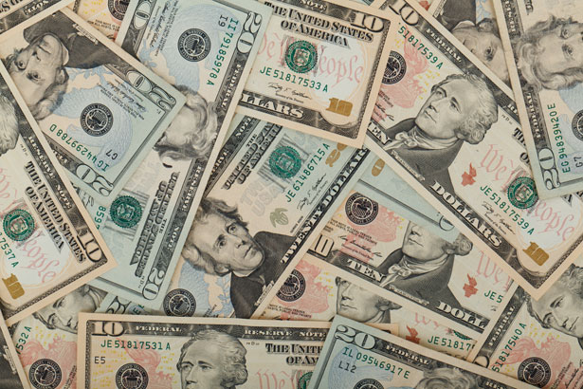
Treasurer’s report
4/20/2023
ASSETS
Checking/Savings
American Rescue Plan Fund 135,709.98
Capital Reserve - DPW 10,728.61
Capital Reserve - Police 5,021.82
Crime Watch Fund 222.69
General Fund - Community 115,614.18
General Fund - FNB 6,270.88
Holiday Lights Fund 1,459.09

Slide 4
Treasurer’s report
Investment - General Fund 1,024.46
Investment - Liquid Fuels 22,556.55
Investment - Paving Fund 1,035.11
Investment - Recycling 113.16
Investment - Refuse 159.81
Liquid Fuels - FNB 67,871.38
Petty Cash 223.00
Recreations Fund 27,190.73
Recycling - Community 1,875.76
Refuse Checking - FNB 112,559.95
Total Checking/Savings 509,637.16

Slide 5
Treasurer’s report
200000 · Accounts Payable 91,853.04
Long Term Debt 240,331.54

